Slide 1
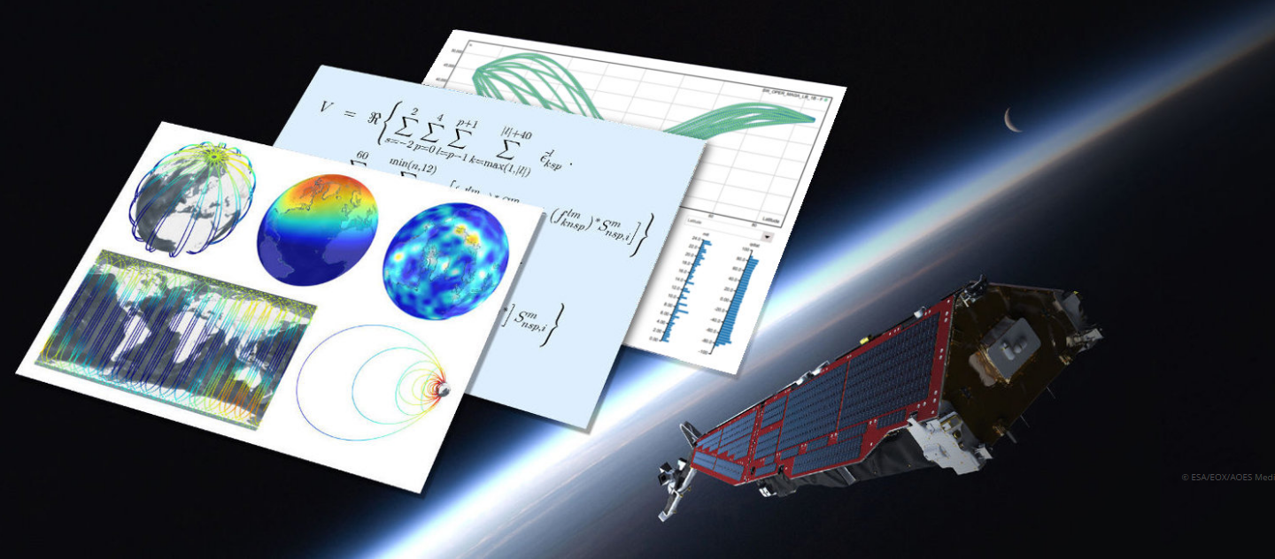
VirES for Swarm v2.0

Slide 2
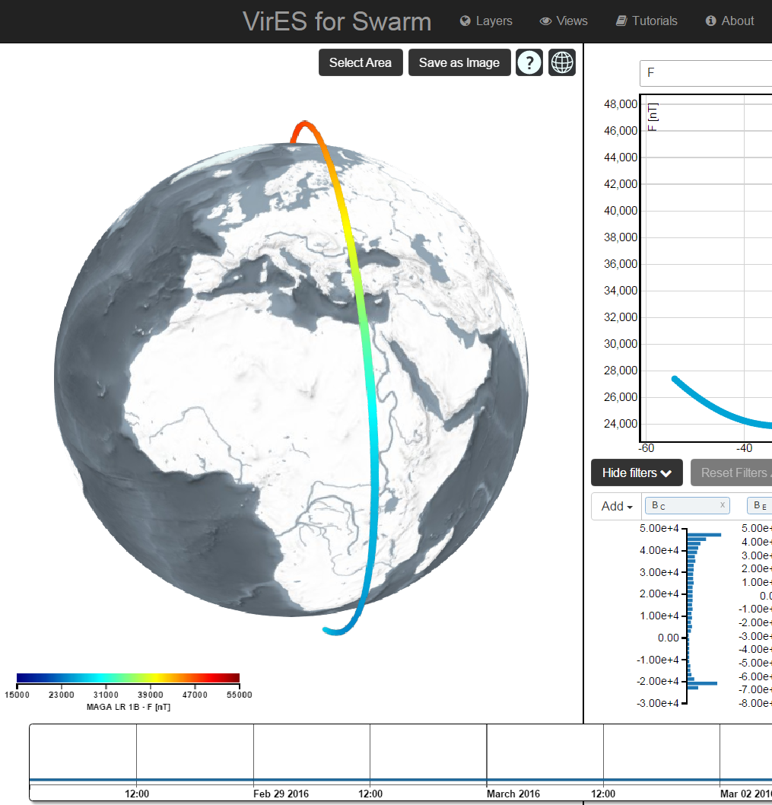
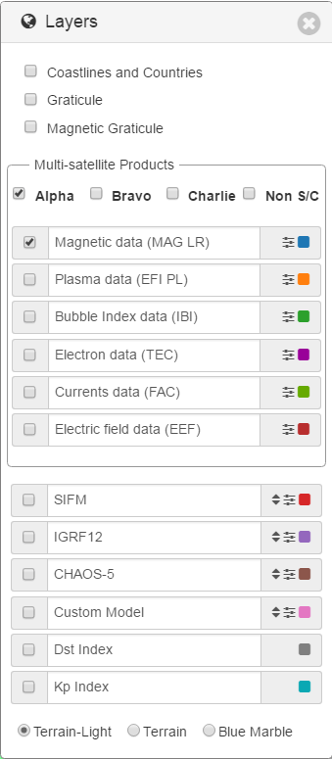
Layers
Layers widget provides the possibility to select the specific data to be visualized. It can be activated by clicking on the “Layers” button on the dashboard.
Available layers:
Cartographic layers: Coastlines and Countries, Graticule, Magnetic Graticule, visualized on the map.
Swarm products: data of the selected type and satellite are visualized on the map and in the analytic view.
Magnetic Models: models representations are visualized on the map.
Kp and Dst indices are visualized in the analytic view.
Raster textures are visualized on the map.
In case of Swarm products, magnetic models, Kp and Dst indices, once the layer is activated, the data availability is shown in the time bar.

Slide 3
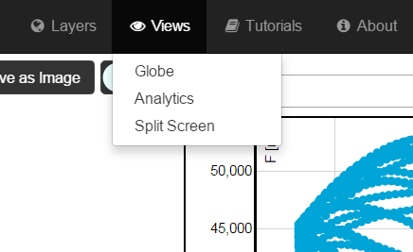
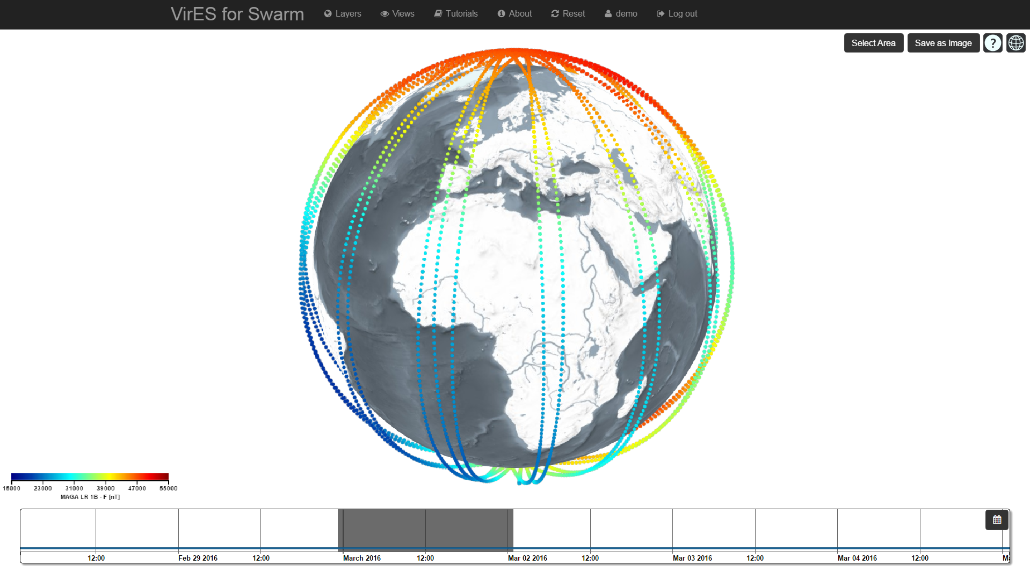
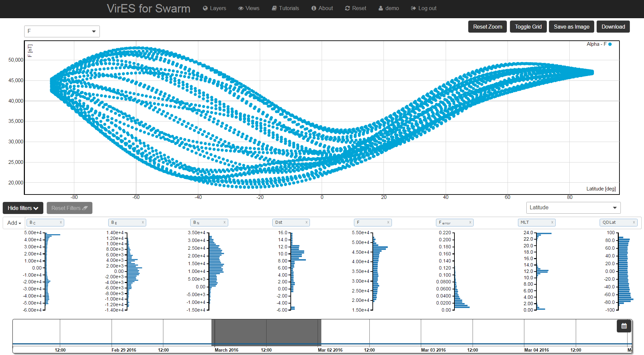
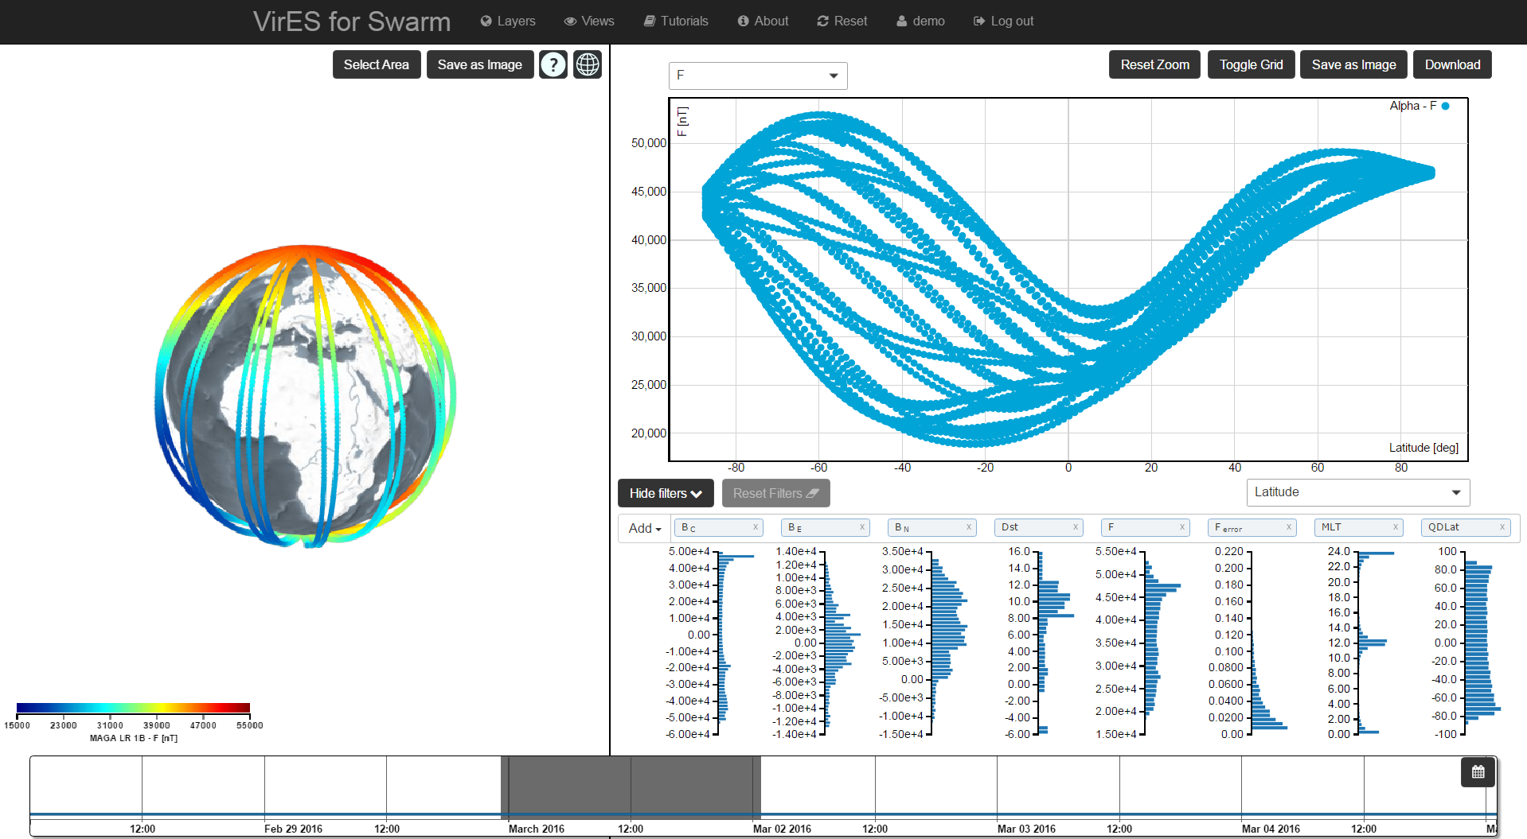
Views
Globe View
Analytics View
It is possible to change the active view by clicking on the “Views” button on the dashboard. The available views are:
Globe View: world map
Analytics View: scatter plot and histograms
Split Screen: combination of world map and scatter plot.
Split Screen

Slide 4
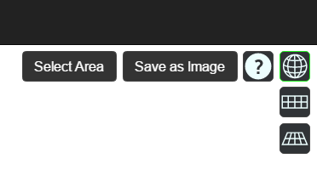
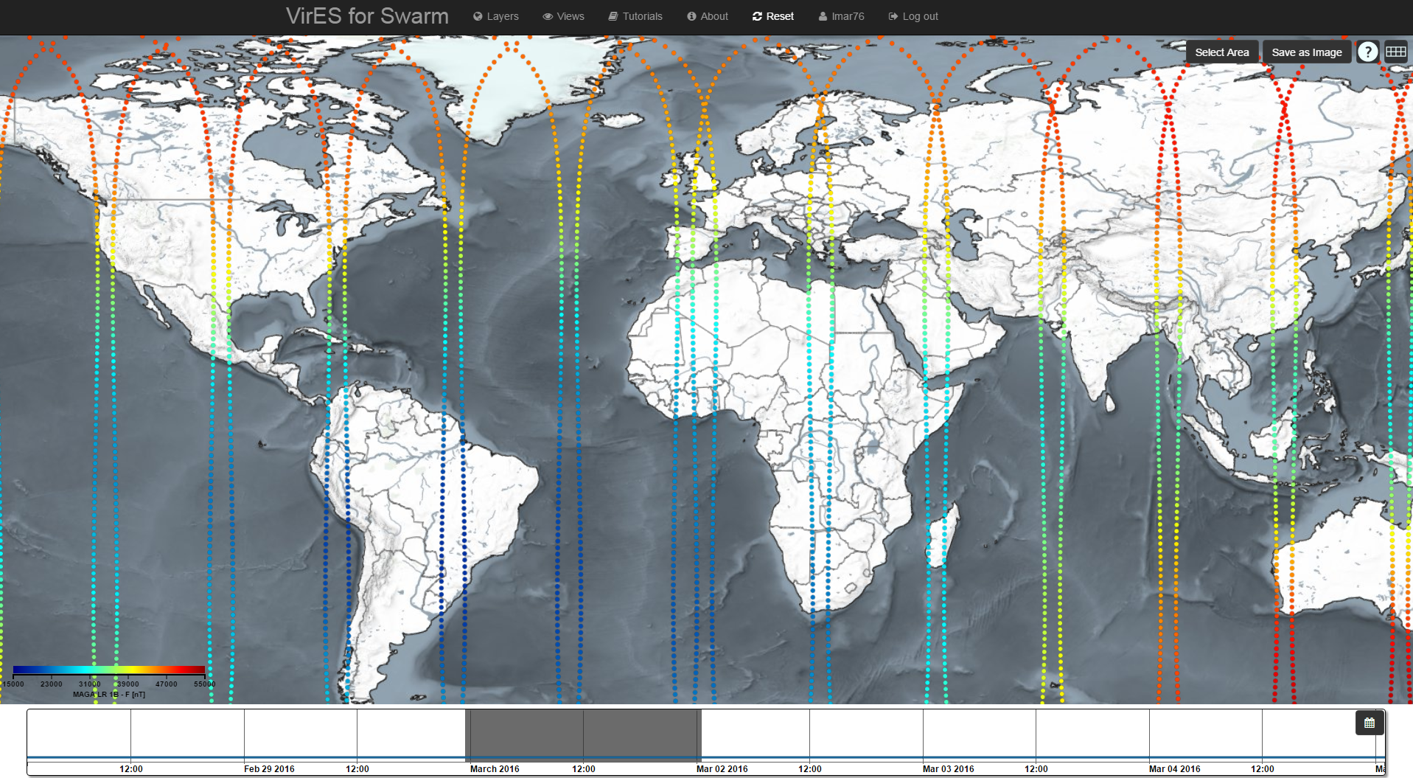
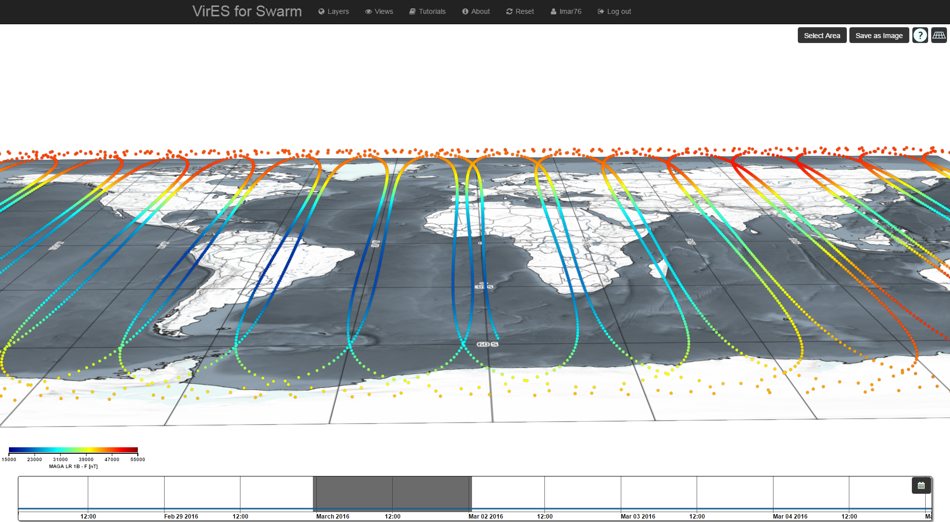
View Projections
3D
In the Globe View, the map projection can be changed between:
Globe View (3D)
Cartesian Grid (2D)
Columbus View
The “Save as Image” button allows to save the map into a file.
2D
Columbus

Slide 5
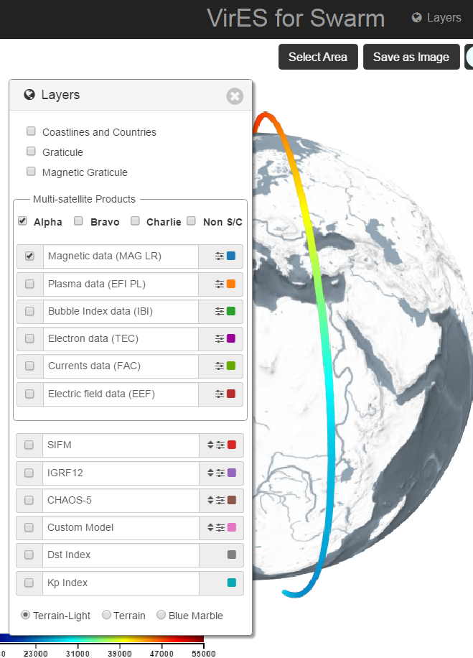
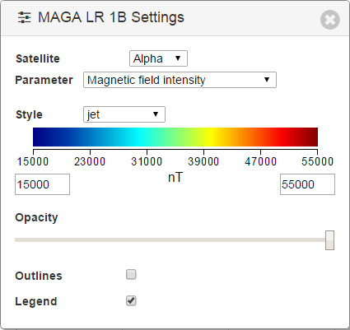
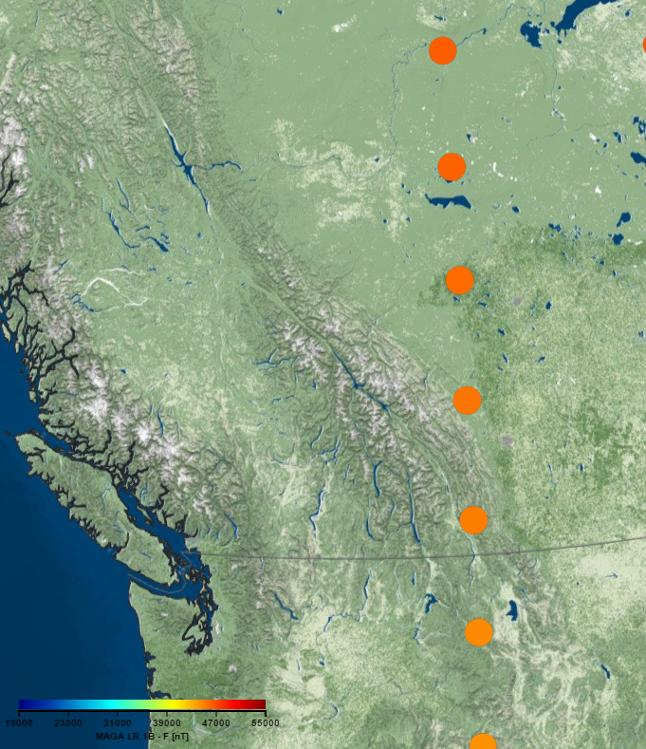

Product parameters and settings
Settings widget can be activated clicking on the button near the product’s name.
Available settings:
Satellite: select between satellite Alpha, Bravo, Charlie or Not spacecraft specific data (currently used to select FAC combined products).
Parameter to be visualized on the map. It depends on the product type (e.g. “Magnetic field intensity” for Magnetic data, “Plasma density” for plasma data).
Colours style and scale range of the parameter visualized on the map.
Opacity: opacity of the plot over the map
Outlines: activate/deactivate outlines.
Legend: activate/deactivate legend.
E.g.: change the opacity and outlines:

Slide 6
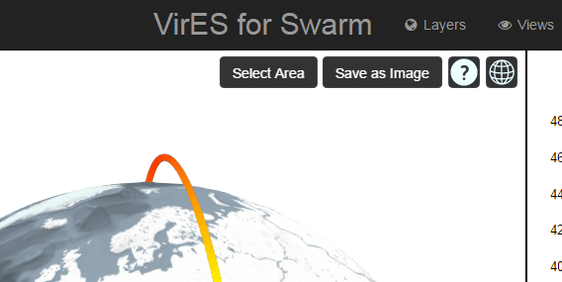
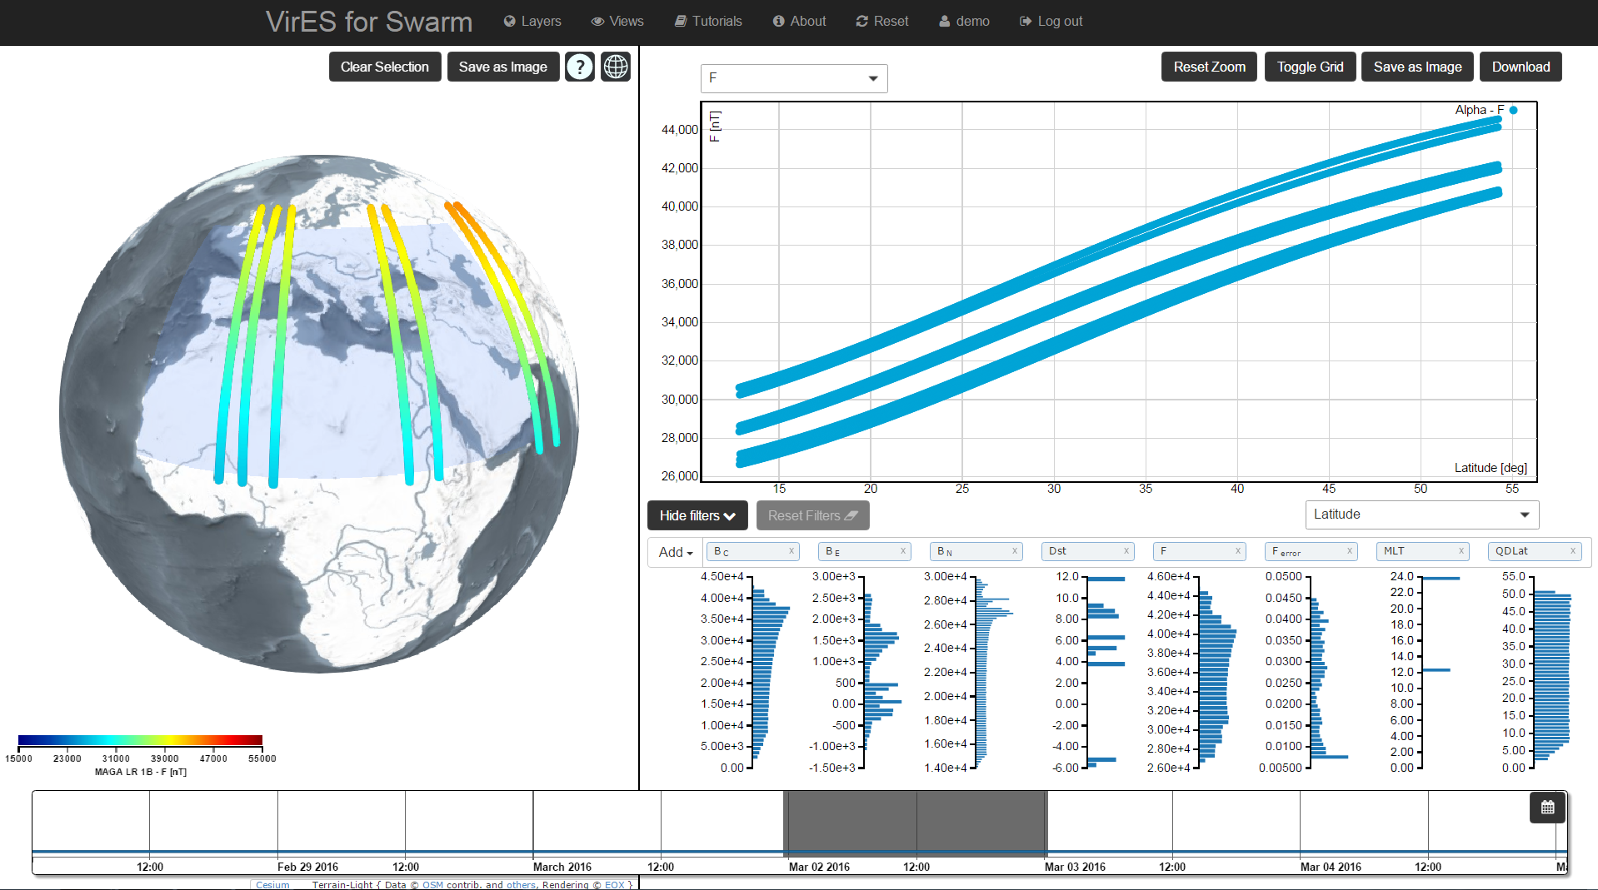
Spatial and Temporal Data Selection
It is possible to select a specific area of interest by clicking on the “Select Area” button and drawing a rectangle on the map.
The area can be de-selected with the “Clear Selection” button.
It is possible to select the desired time-span by clicking and dragging an area on the time slider.
The line visualized over the time slider represents the data availability and depends on the selected layer.
Plot and histograms are automatically updated according to the spatial and temporal selections.

Slide 7
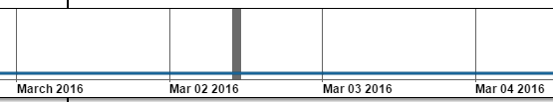
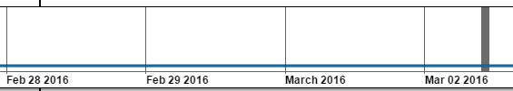
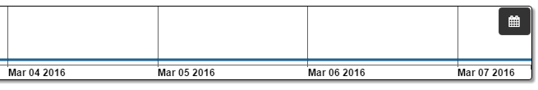
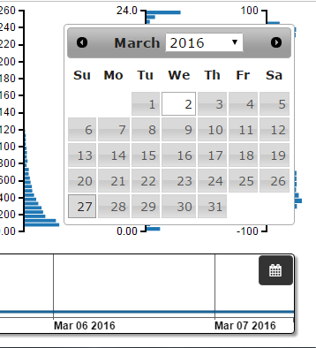
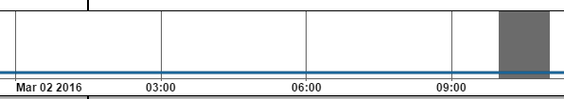
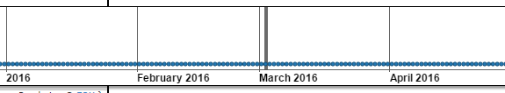
Time Slider: date selection
Left button + drag left/right: change date
Jump to date: click the button on the top right corner of the time slider to easily select the date
Wheel mouse: zoom in/out time scale

Slide 8
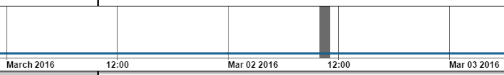
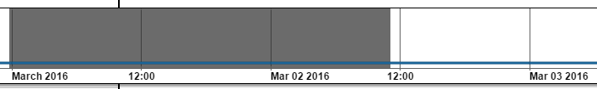
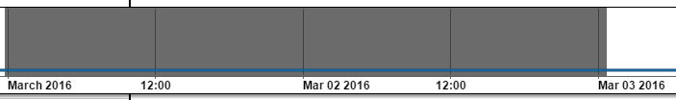
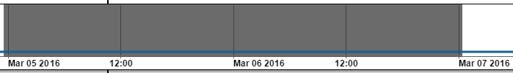
Time window update
Click and drag the time window borders to increase/decrease size
Click and drag the time window to move it leaving its size unchanged

Slide 9
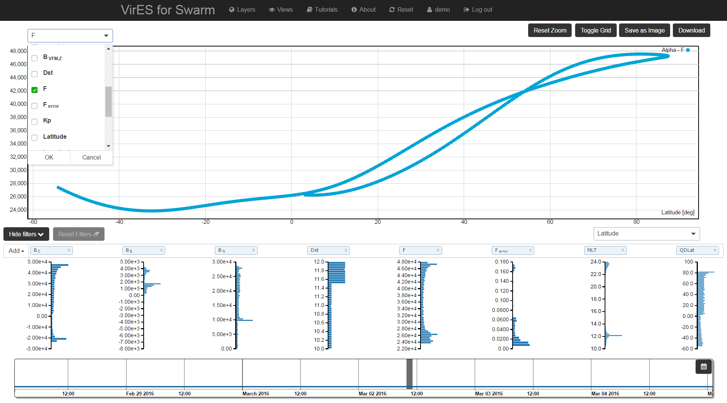
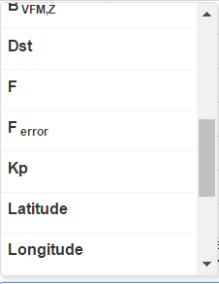
Analytics View: parameters selection
Scatter Plot can be customized selecting the parameters to be represented on the X-axis and Y-axis
The “Save as Image” button can be used to save the plot into a file.

Slide 10
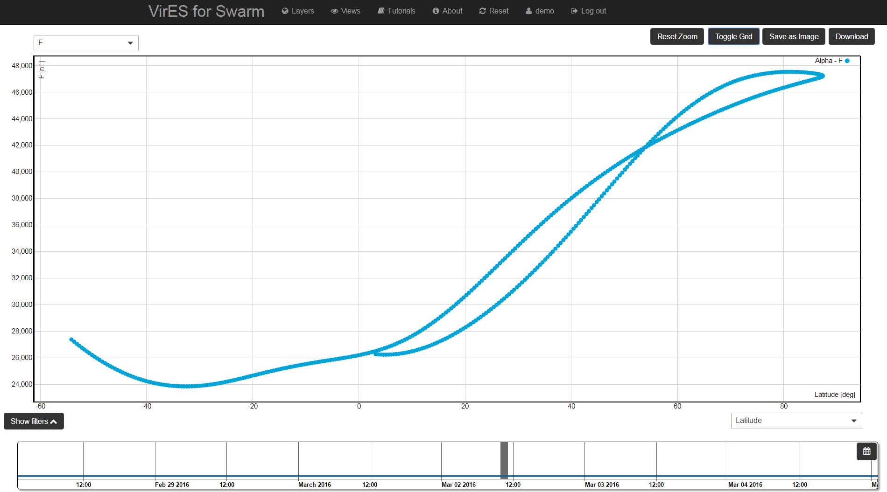
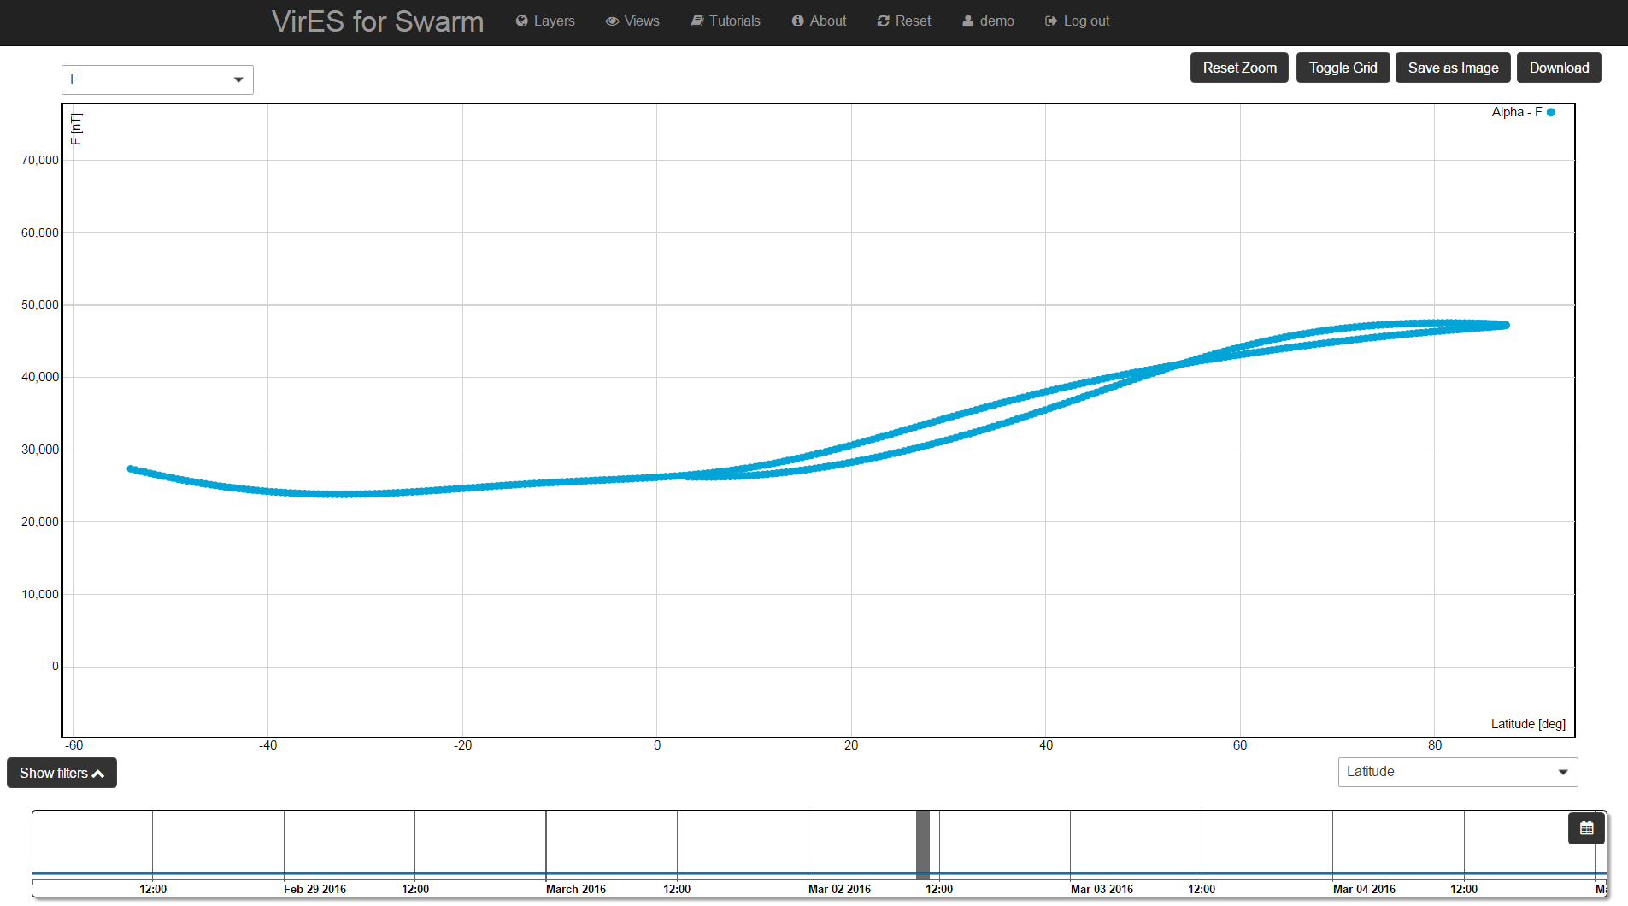
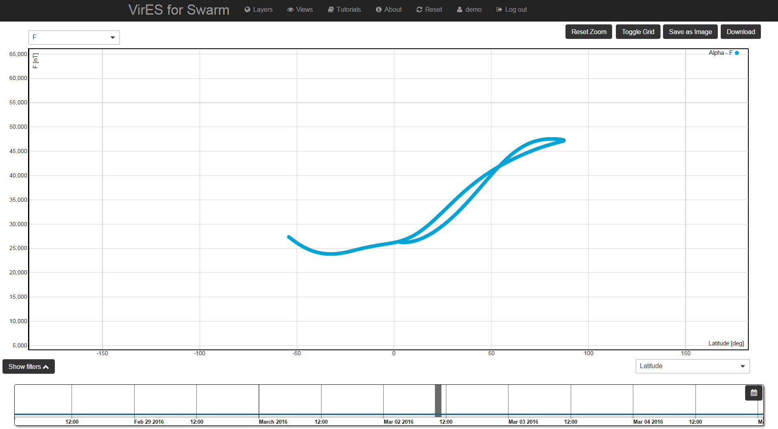
Analytics View: zoom
Changing the zoom level:
Mouse pointer over one axes + mouse wheel: change zoom level on a single axes
Mouse pointer on the scatter plot + mouse wheel: change zoom level on both axis
Reset Zoom button: resume the original plot

Slide 11
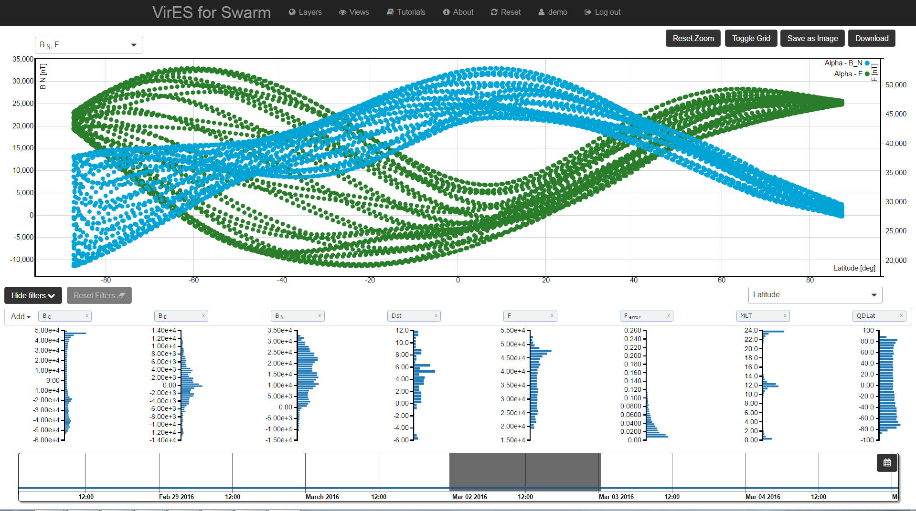
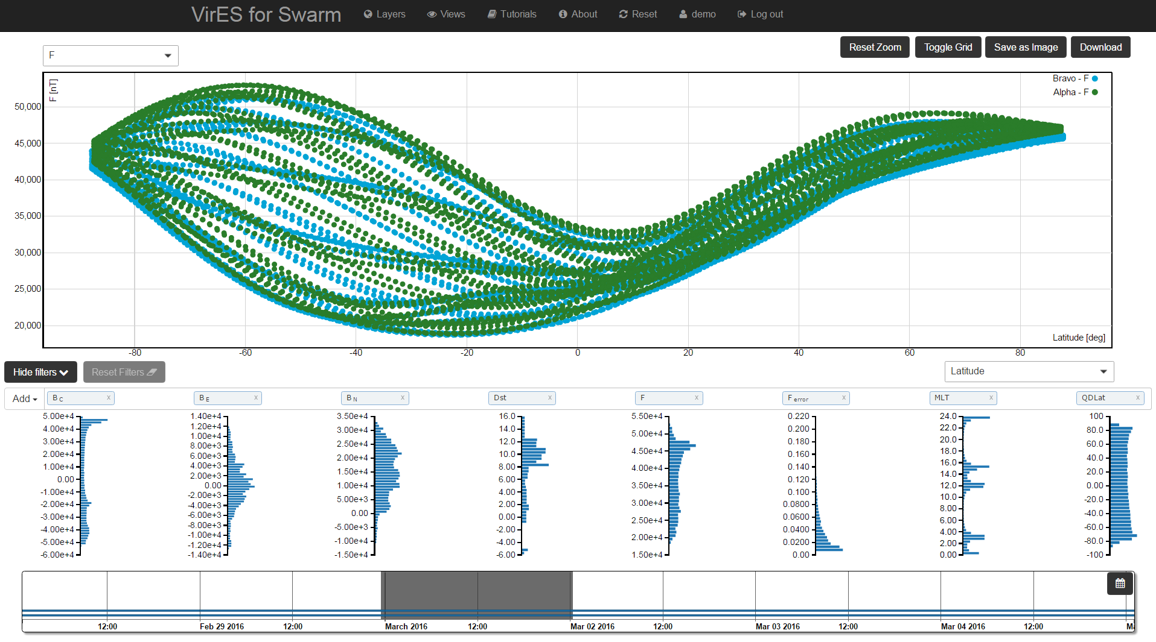
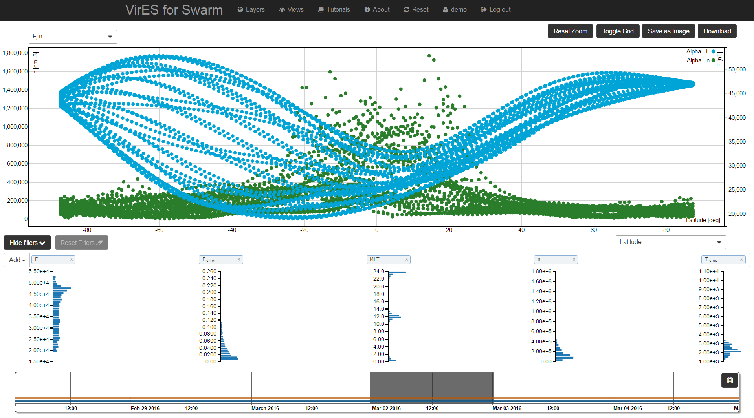
Data over-plotting
1
Selecting different combinations of layers and/or spacecrafts it is possible to visualize more parameters in the same plot. E.g.:
Same product, same spacecraft, different parameters
Same product, different spacecrafts, same parameters
Different products, different parameters, same spacecraft
2
3

Slide 12
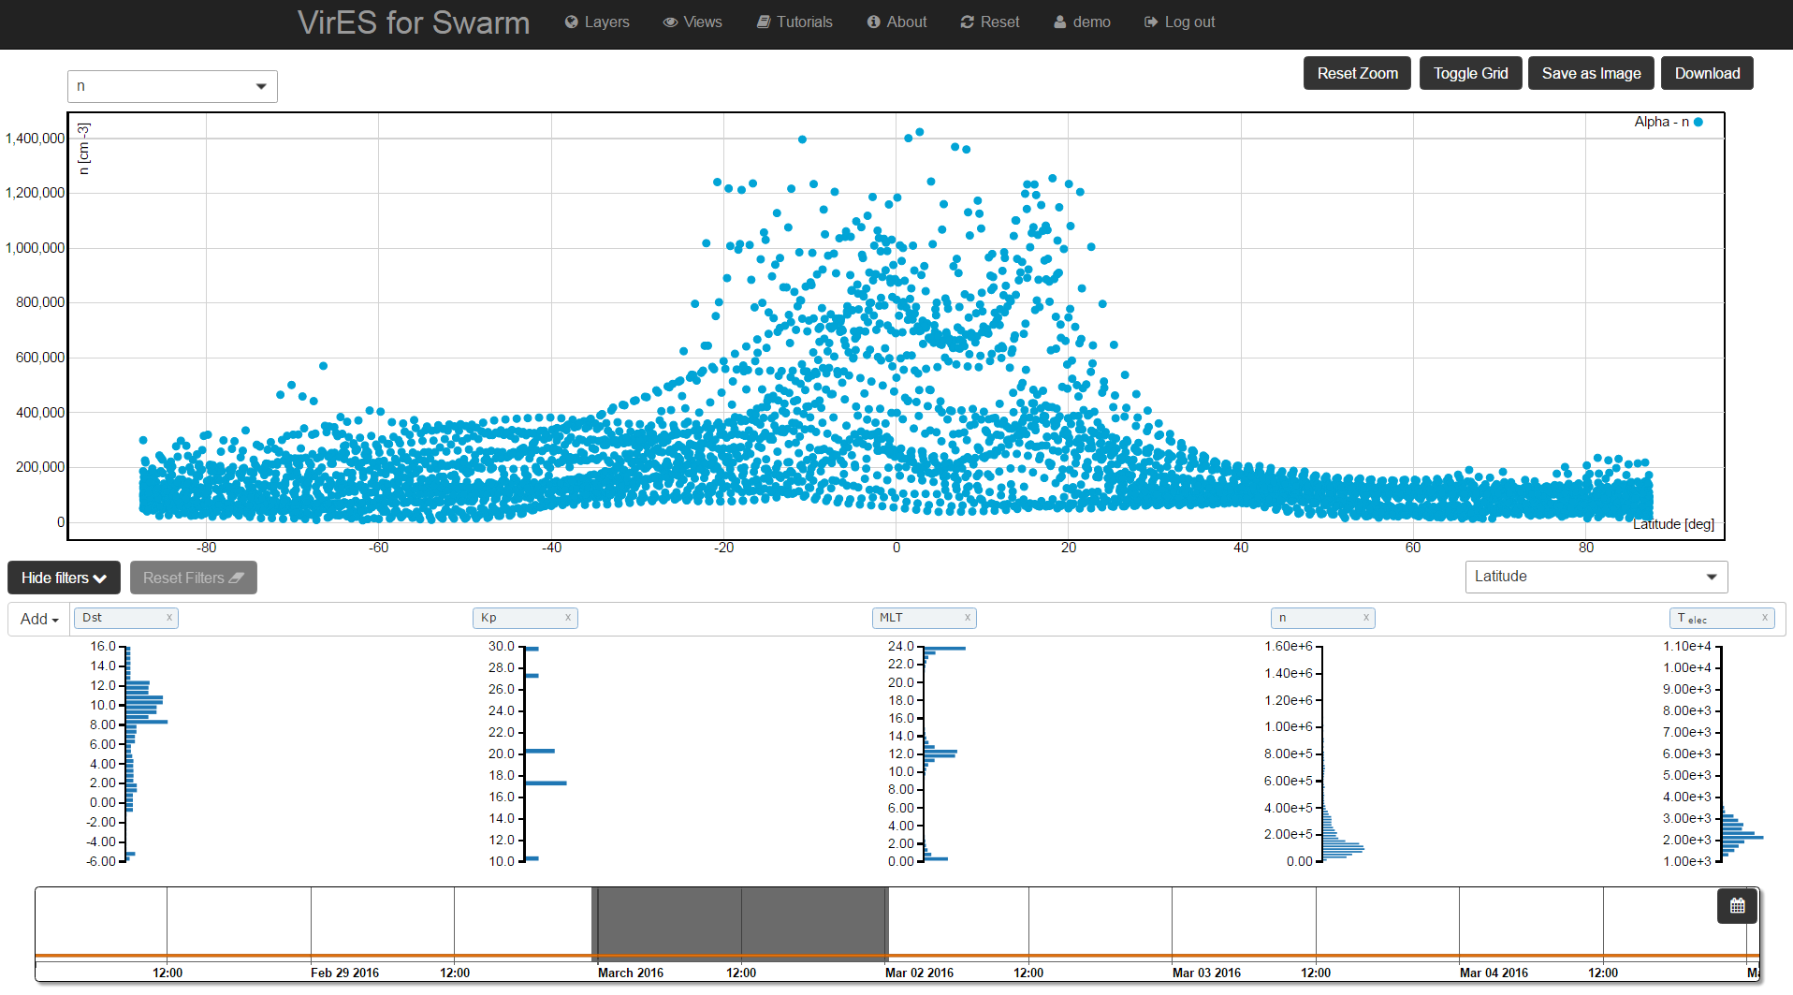
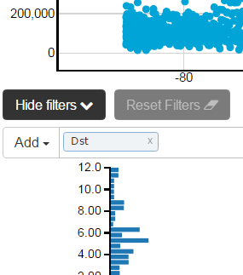
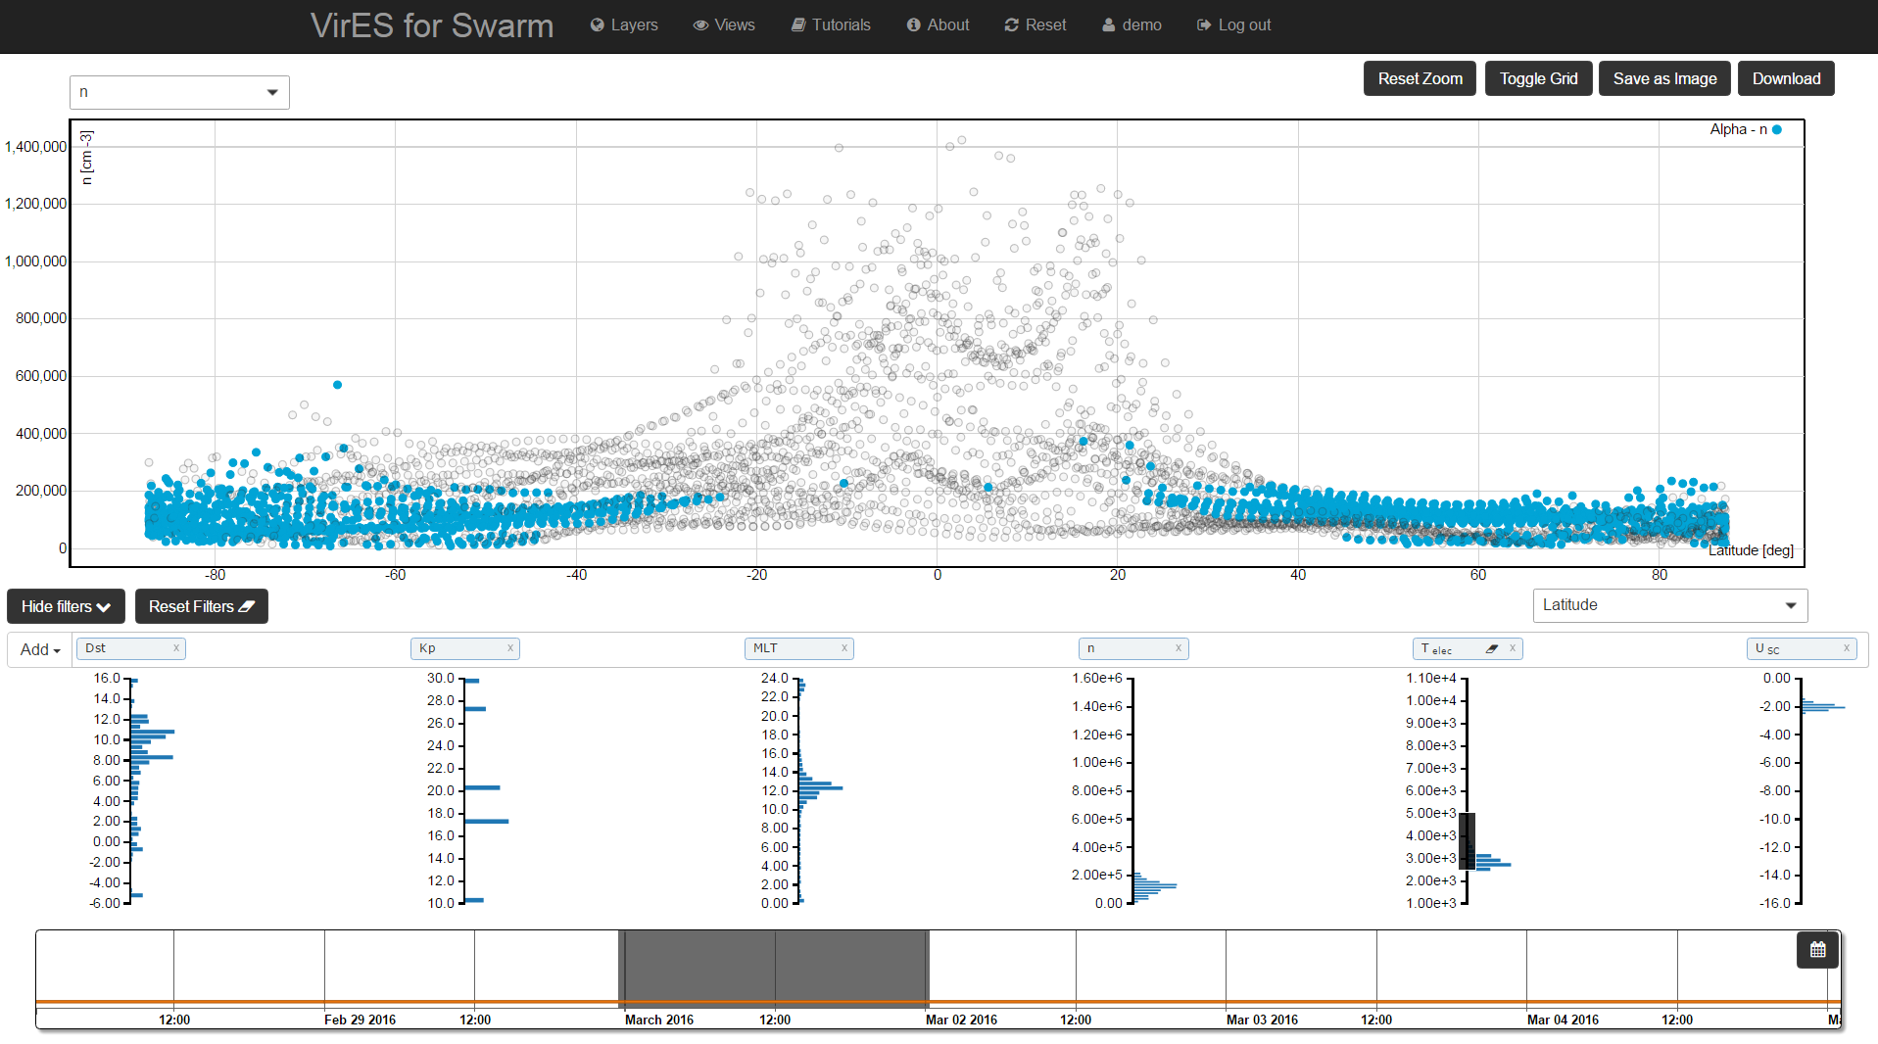
Data Filtering
It is possible to filter data according to a specific parameter by clicking and dragging with the mouse over the desired histogram.
If the parameter is not present in the histograms list, it can be added clicking on the “Add” button.
Original data visualization can be resumed clicking on the “Reset Filters” button.
Histograms can be hidden by clicking on the “Hide Filters” button.
E.g.: 2.5 e3 K ≤ Telec ≤ 5 e3 K

Slide 13
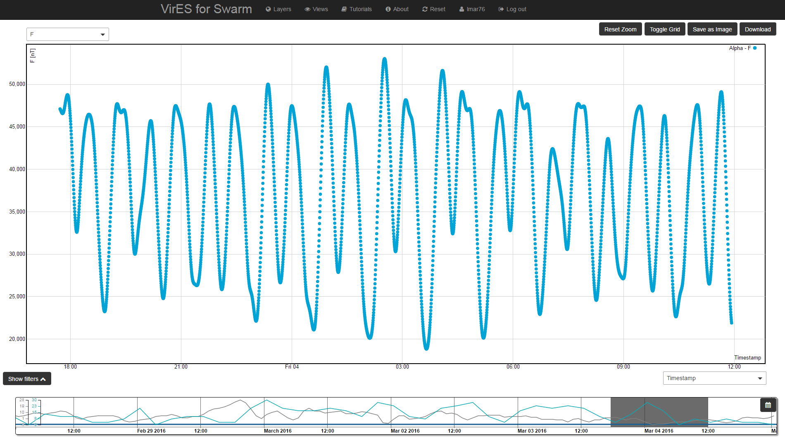
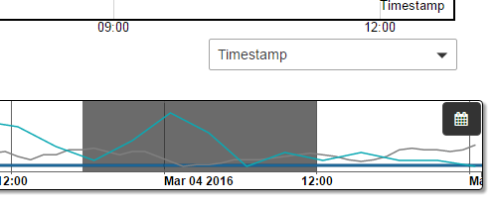
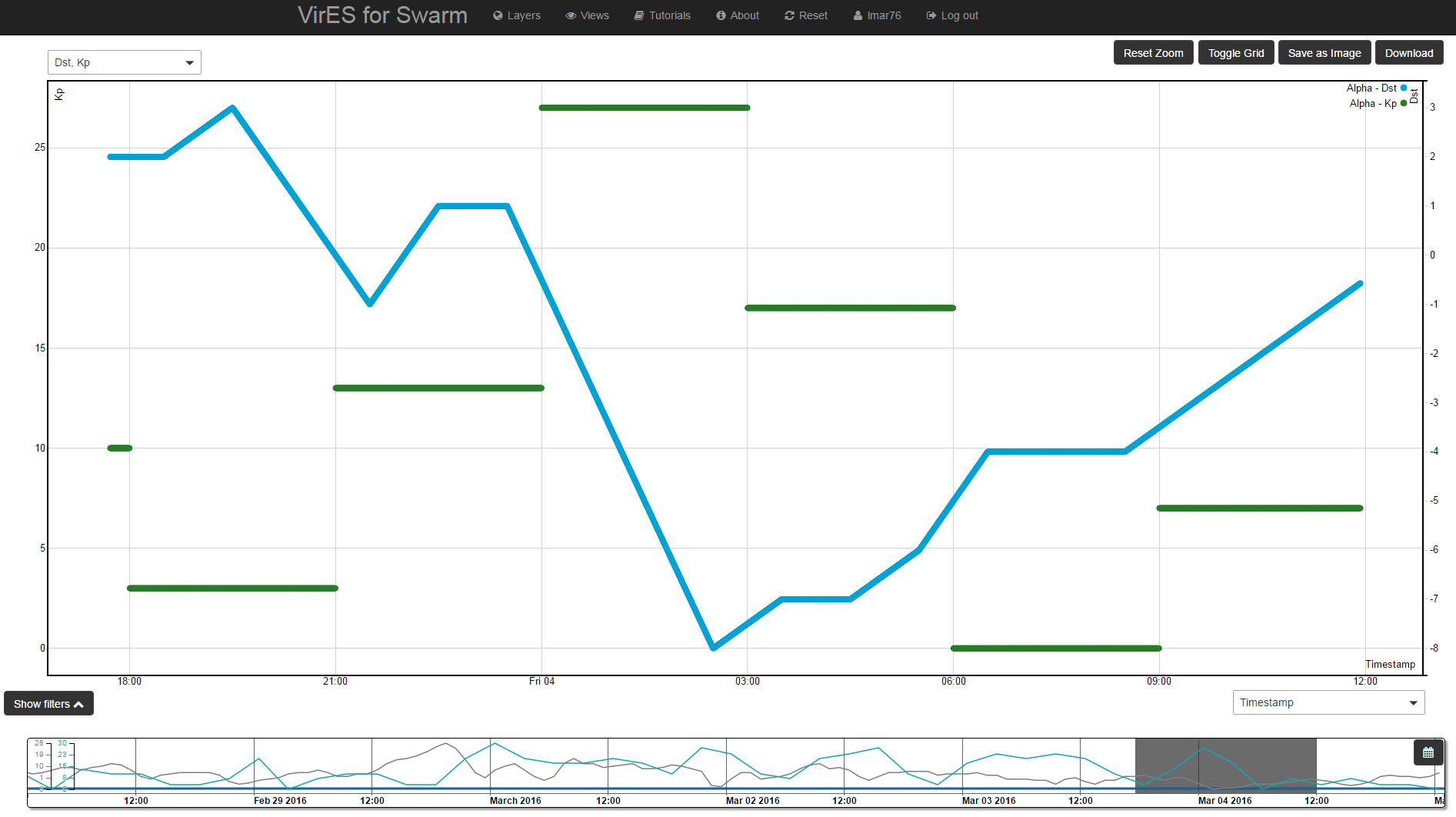
Kp and Dst Visualization
Kp and Dst indices are visualized on the time bar. These representation can be used to select a time window having particular Kp and Dst values.

Slide 14
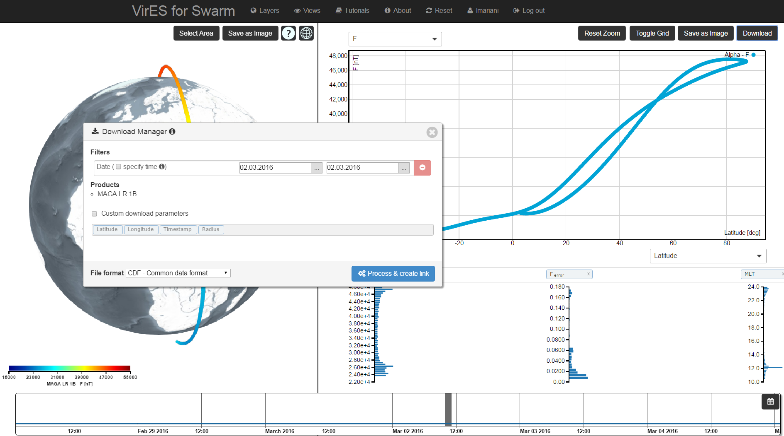
Data Download
The Download Manager allows the user to download the selected product.
It can be activated by clicking on the “Download” button.

Slide 15
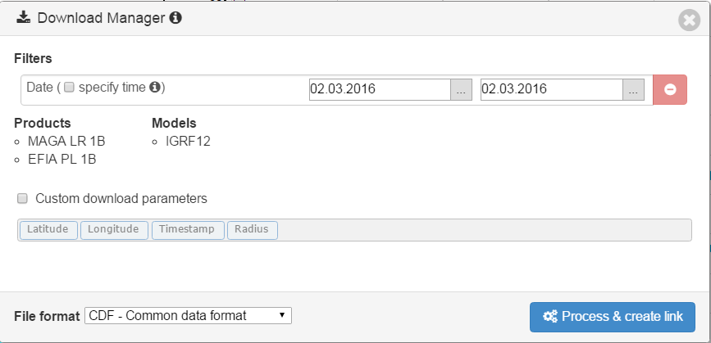
Download Manager: settings
Filters section reports, by default, the currently selected start and stop dates (it can be modified), the selected area of interest (if any) and any selected filter on the histograms.
Products/Models section reports the currently selected products and models.
Custom download parameters section allows the user to select a specific subset of the parameters to be included in the output product.
File format allows the user to select the output file format: CDF (default) or CSV.
Process & create link button allows the user to start the creation of the selected product file. Once the file is ready to be download, a download button appears.

Slide 16
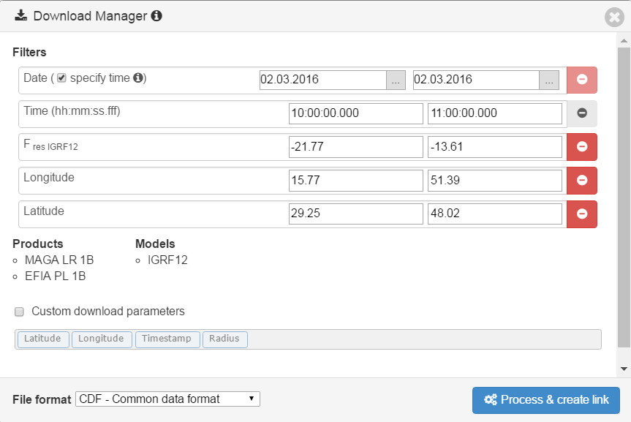
Download Manager: filters
Start and stop dates are initially set to the start and stop dates of the selected time window.
It is possible to specify the start and stop time selecting the “specify time” checkbox.
Any filter applied on the histograms is reported indicating the parameter and the minimum and maximum values.
If an area of interest is selected, the latitude and longitude information is reported
With the exception of dates, it is possible to remove the filters clicking on the red button.

Slide 17
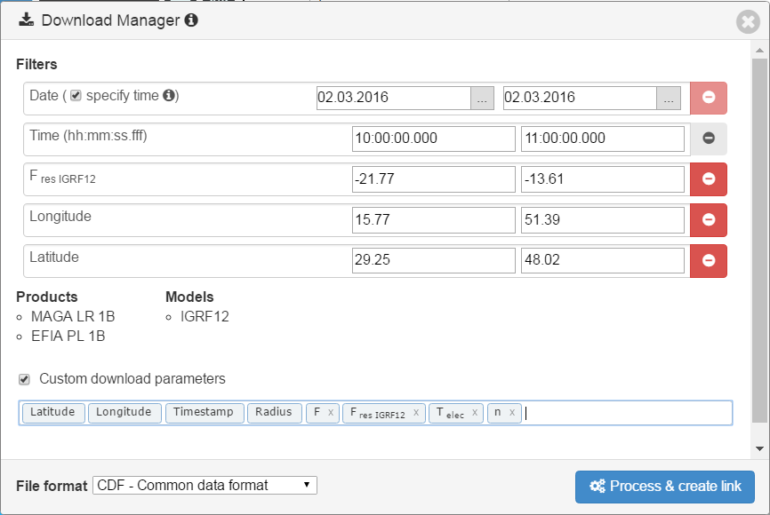
Download Manager: custom download parameters
The product’s content can be customised by selecting the “Custom download parameters” checkbox and adding the desired parameters from the list. In this way, only the selected parameters will be included in the output product.

Slide 18
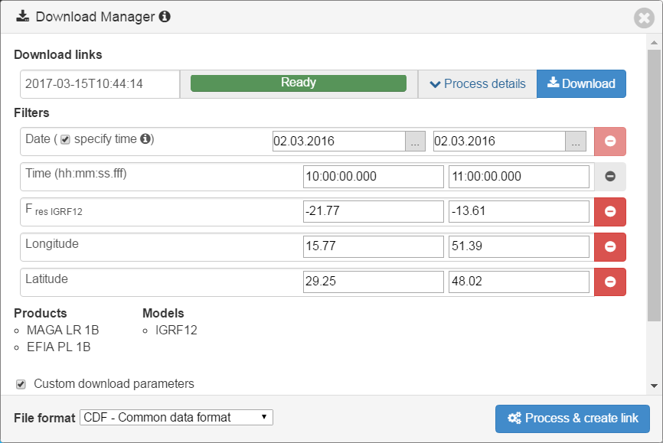
Download Manager: product preparation and download
After having customized the date and time ranges, the area of interest, the filtering parameters and the output parameters, the product can be processed by clicking on the “Process & create link” button.
The download link appears with a progress indicator. Once the product is ready, it can be downloaded by clicking on the “Download” button.

Slide 19
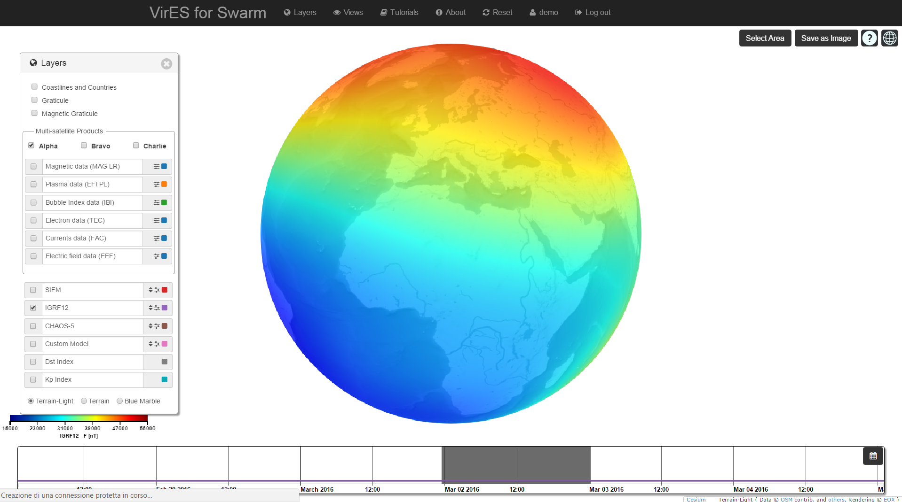
View of magnetic field models: SIFM, IGRF12, CHAOS-5
Three predefined models: SIFM, IGRF12, CHAOS-5

Slide 20
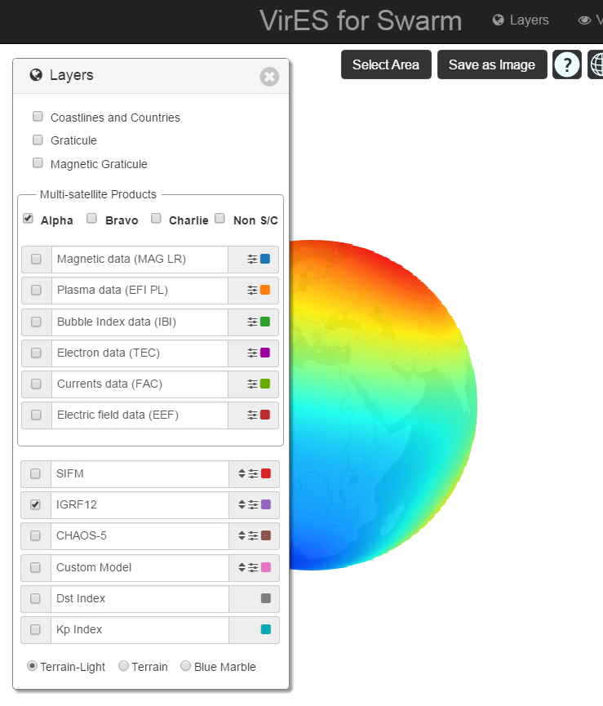
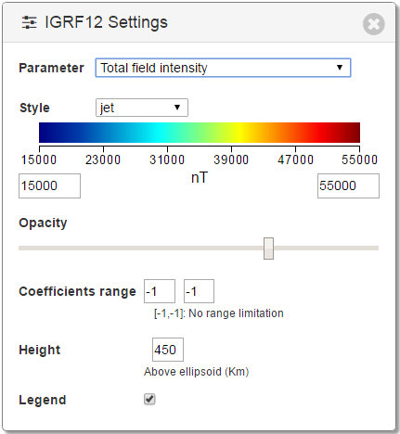
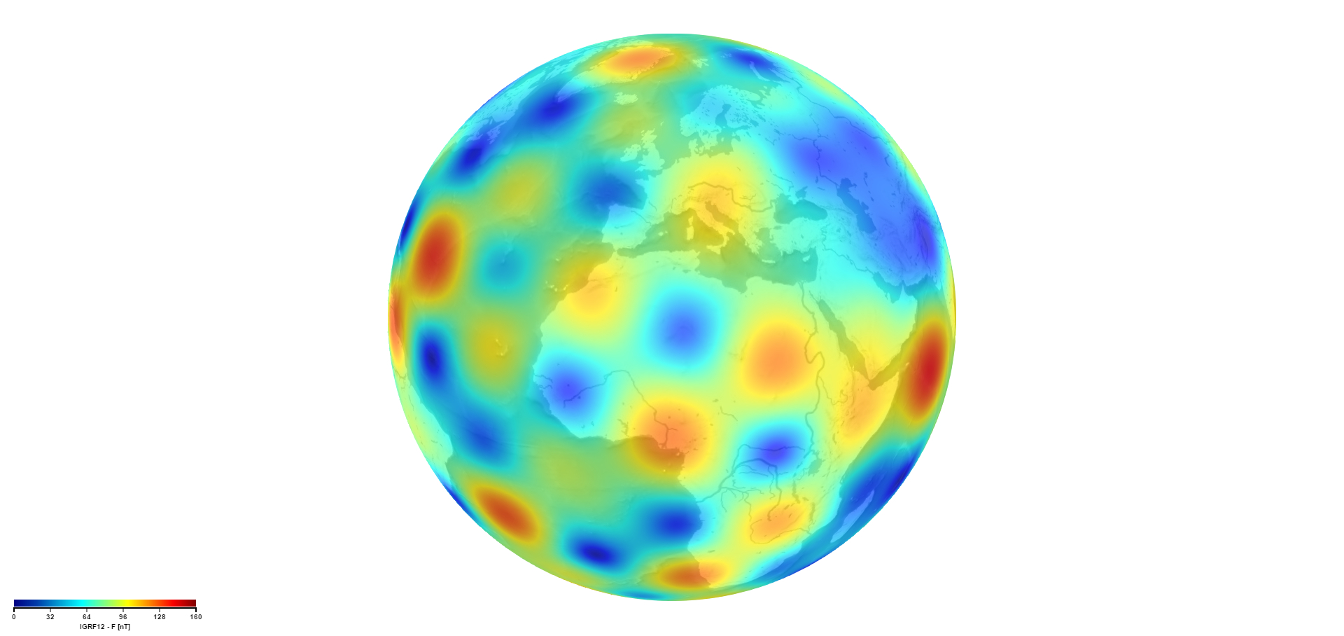
Model parameters and settings
Settings widget can be activated clicking on the button near the model’s name.
Available settings:
Parameter to be visualized on the map (e.g. “Total field intensity”, “Fieldlines”, etc.)
Colours style and scale range of the parameter visualized on the map.
Opacity: opacity of the field map.
Coefficients range of the spherical harmonics expansion.
Height: reference height.
Legend: activate/deactivate legend.
E.g.: coefficients range: [10, 13], height: 0 Km

Slide 21
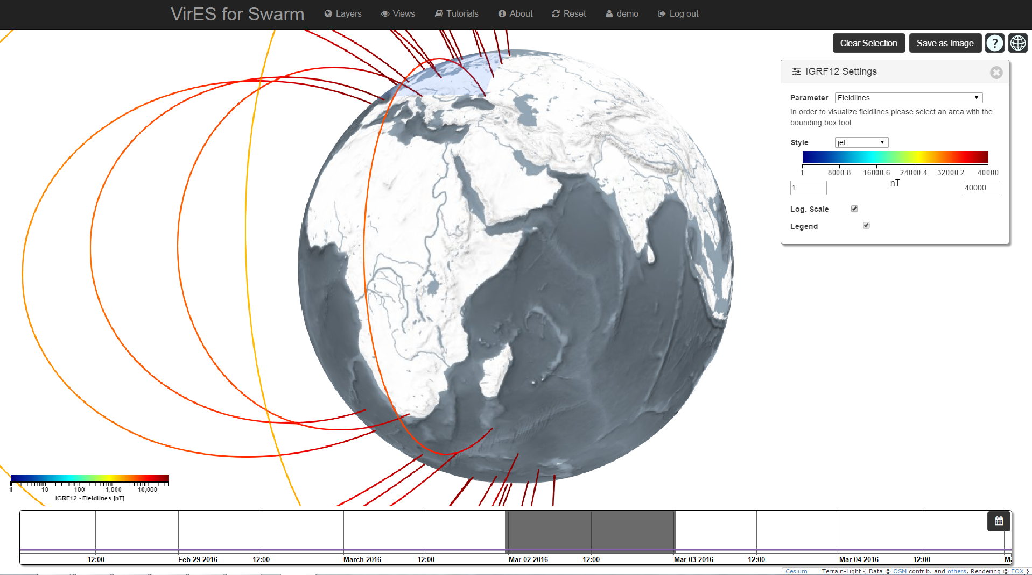
Magnetic field lines
Field lines can be visualized selecting a specific area on the map

Slide 22
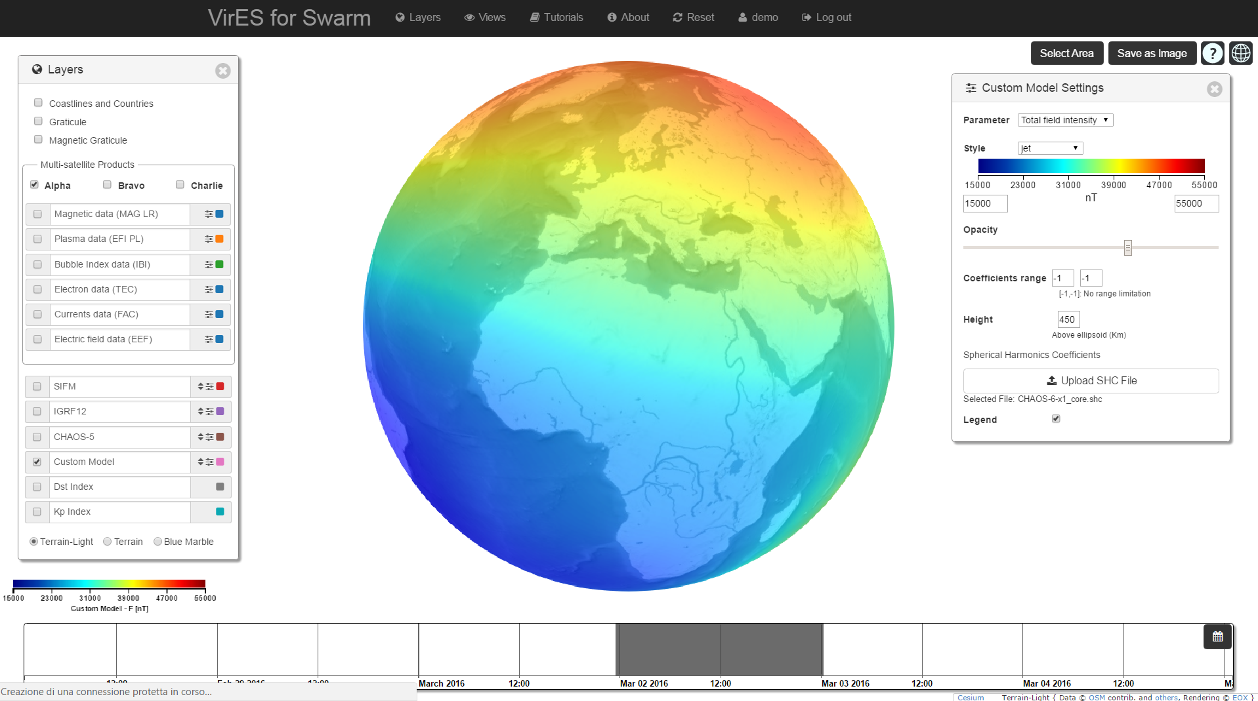
Upload of custom model
In addition to the predefined models, it is also possible to visualize a custom model by uploading a Spherical Harmonic Expansion coefficients file (SHC) [1].
In the example, CHAOS-6 SHC file has been used [2].
[1] Description of SHC file format: http://www.spacecenter.dk/files/magnetic-models/CHAOS-5/SHC-Format-Decsription.pdf
[2] CHAOS-6 SHC file: http://www.spacecenter.dk/files/magnetic-models/CHAOS-6/CHAOS-6-x1_core.shc

Slide 23

Residual visualization and analysis
Selecting Magnetic Data and a magnetic field model it is also possible to visualize, in the analytic view, the residual between the measured parameter and the one calculated with the model.
In the example you can see the residual between the measured F and the field intensity calculated with IGRF12 model.

Slide 24
Thank you for your attention

